Slide 1
Overview over different methods
You are here !

Slide 2
Hebbian learning
When an axon of cell A excites cell B and repeatedly or persistently takes part in firing it, some growth processes or metabolic change takes place in one or both cells so that A‘s efficiency ... is increased.
Donald Hebb (1949)
A
B
A
t
B

Slide 3
Hebbian Learning
ω₁
u₁
v
…correlates inputs with outputs by the…
dω₁
= μ v u₁ μ << 1
…Basic Hebb-Rule:
dt
Vector Notation following Dayan and Abbott:
Cell Activity: v = w . u
This is a dot product, where w is a weight vector and u
the input vector. Strictly we need to assume that weight
changes are slow, otherwise this turns into a differential eq.

Slide 4
Hebbian Learning
dω₁
= μ u₁ v
dt
u₁

Slide 5
dω₁
Single Input
= μ v u₁ μ << 1
dt
dw
Many Inputs
= μ v u μ << 1
dt
As v is a single output, it is scalar.
Averaging Inputs
dw
= μ <v u> μ << 1
dt
We can just average over all input patterns and approximate the weight change by this. Remember, this assumes that weight changes are slow.
If we replace v with w . u we can write:
dw
= μ Q . w where Q = <uu> is
the input correlation
matrix
dt
Note: Hebb yields an instable (always growing) weight vector!

Slide 6
Synaptic plasticity evoked artificially
Examples of Long term potentiation (LTP)
and long term depression (LTD).
LTP First demonstrated by Bliss and Lomo in 1973. Since then induced in many different ways, usually in slice.
LTD, robustly shown by Dudek and Bear in 1992, in Hippocampal slice.

Slide 9
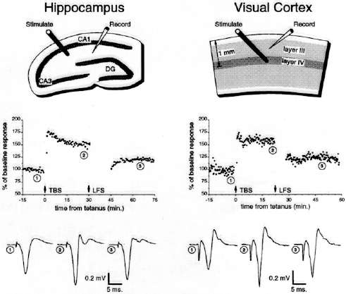
Artificially induced synaptic plasticity.
Presynaptic rate-based induction
Bear et. al. 94
Notes:
There are various common methods for inducing bidirectional synaptic plasticity.
The most traditional one is by using extracellular stimulation at different frequencies. High frequency produces LTP whereas low frequency may produce LTD.
Another protocol is often called paring. Here the postsynaptic cell is voltage clamped to a certain postsynaptic voltage and at the same time a low frequency presynaptic stimuli is delivered. For small depolarization to ~-50 mv LTD is induced and depolarization to –10 produces LTP.
A third recently popular protocol is spike time dependent plasticity STDP – here a presynaptic stimuli is delivered either closely before of after a postsynaptic AP. Typically if the pre comes before the post LTP is induced and if post comes before pre LTD is produced.

Slide 10
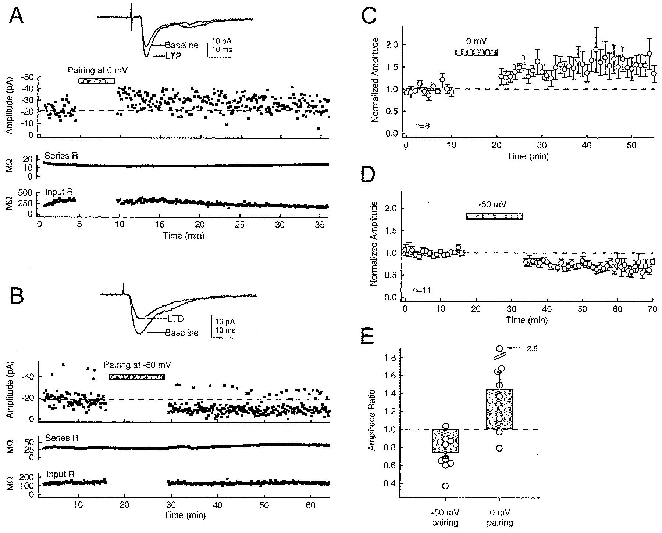
Depolarization based induction
Feldman, 2000
Notes:
There are various common methods for inducing bidirectional synaptic plasticity.
The most traditional one is by using extracellular stimulation at different frequencies. High frequency produces LTP whereas low frequency may produce LTD.
Another protocol is often called paring. Here the postsynaptic cell is voltage clamped to a certain postsynaptic voltage and at the same time a low frequency presynaptic stimuli is delivered. For small depolarization to ~-50 mv LTD is induced and depolarization to –10 produces LTP.
A third recently popular protocol is spike time dependent plasticity STDP – here a presynaptic stimuli is delivered either closely before of after a postsynaptic AP. Typically if the pre comes before the post LTP is induced and if post comes before pre LTD is produced.

Slide 12
LTP will lead to new synaptic contacts

Slide 14
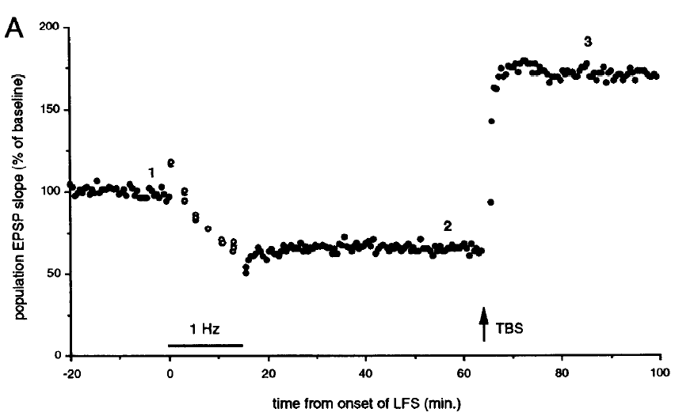
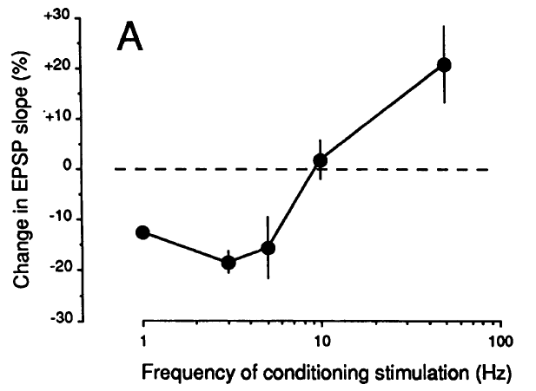
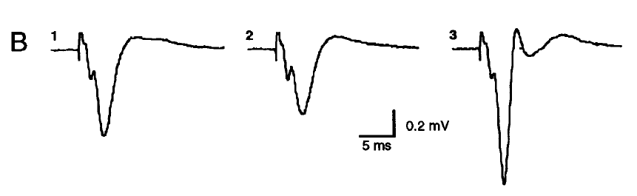
Synaptic Plasticity:
Dudek and Bear, 1993
LTP
(Long-Term
Potentiation)
LTD
(Long-Term Depression)
100 Hz
LTP
LTD

Slide 15
Conventional LTP
Synaptic change %
Pre
Post
Post
Pre
t_{Pre}
t_{Post}
t_{Pre}
t_{Post}
Symmetrical Weight-change curve
The temporal order of input and output does not play any role

Slide 16
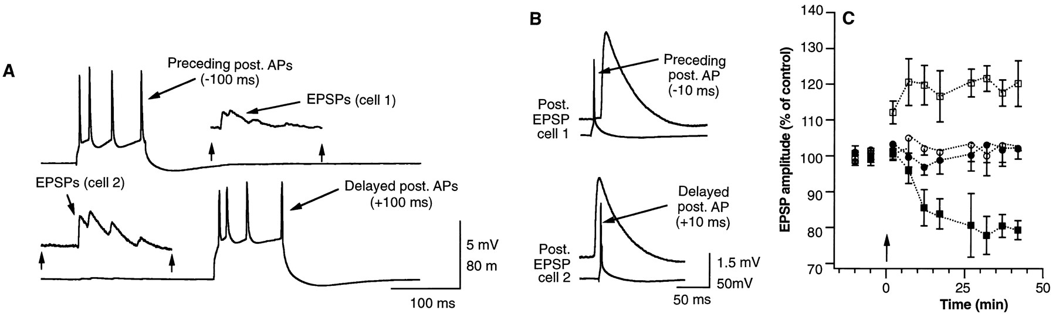
Spike timing dependent plasticity - STDP
Post before Pre: LTD
+10 ms
Pre before Post: LTP
-10 ms
Markram et. al. 1997
Notes:
16

Slide 17
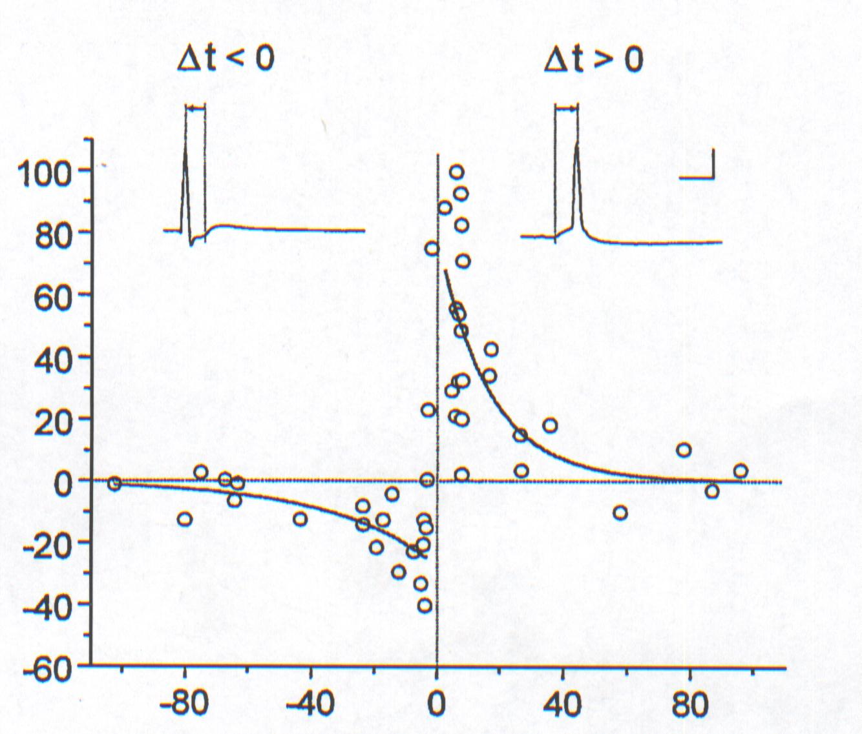
Spike Timing Dependent Plasticity: Temporal Hebbian Learning
Synaptic
change %
Pre
Post
Acausal
t_{Pre}
t_{Post}
Post
Pre
Pre precedes Post:
Long-term
Potentiation
t_{Pre}
t_{Post}
Pre follows Post:
Long-term
Depression
Causal
(possibly)
Weight-change curve (Bi&Poo, 2001)

Slide 18
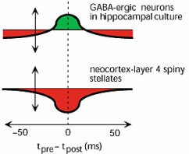
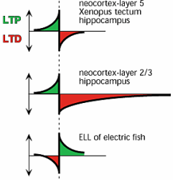
Different Learning Curves
(Note: X-axis is pre-post,
We will use: post - pre,
which seems more natural)

Slide 19
At this level we know much about the cellular and molecular basis of synaptic plasticity.
But how do we know that “synaptic plasticity” as observed on the cellular level has any connection to learning and memory?
What types of criterions can we use to answer this question?

Slide 20
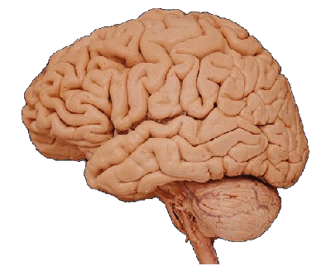

Synaptic Plasticity and Memory Hypothesis
'Activity-dependent synaptic plasticity is induced at appropriate
synapses during memory formation, and is both necessary and
sufficient for the information storage […].’
(Martin et al., 2000; Martin and Morris, 2002)
Learning
Synaptic Plasticity
Memory
Cell Assembly
James, 1890; Hebb, 1949

Slide 21
Assessment criterions for the synaptic hypothesis:
(From Martin and Morris 2002)
1. DETECTABILITY: If an animal displays memory of some previous experience (or has learnt a new task), a change in synaptic efficacy should be detectable somewhere in its nervous system.
2. MIMICRY: If it were possible to induce the appropriate pattern of synaptic weight changes artificially, the animal should display ‘apparent’ memory for some past experience which did not in practice occur.
Garner et al. 2012, Science, 335, 1513-1516

Slide 22
3. ANTEROGRADE ALTERATION: Interventions that prevent the induction of synaptic weight changes during a learning experience should impair the animal’s memory of that experience (or prevent the learning).
4. RETROGRADE ALTERATION: Interventions that alter the spatial distribution of synaptic weight changes induced by a prior learning experience (see detectability) should alter the animals memory of that experience (or alter the learning). Similarly: Stimulation of a set of learned neuron should elicit a memory.
Liu et al. 2012, Nature

Slide 23
Proof the SPM Hypothesis
Detectability: If an animal displays memory of some previous experience, a change in
synaptic efficacy should be detectable somewhere in its nervous system.
Mimicry: Conversely, if it were possible to induce the same spatial pattern of synaptic weight
changes artificially, the animal should display 'apparent' memory for some past experience
which did not in practice occur.
Anterograde Alteration: Interventions that prevent the induction of synaptic weight changes
during a learning experience should impair the animal's memory of that experience.
Retrograde Alteration: Interventions that alter the spatial distribution of synaptic weights
induced by a prior learning experience (see detectability) should alter the animal's memory
of that experience.
Martin et al., 2000; Martin and Morris, 2002

Slide 24
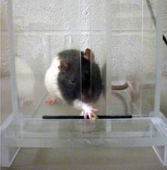
Detectability
Example from Rioult-Pedotti - 1998
Learn to reach for food
rat
paw
food
Rats were trained for three or five days in a skilled reaching task with one forelimb, after which slices of motor cortex were examined to determine the effect of training on the strength of horizontal intracortical connections in layer II/III.

Slide 25
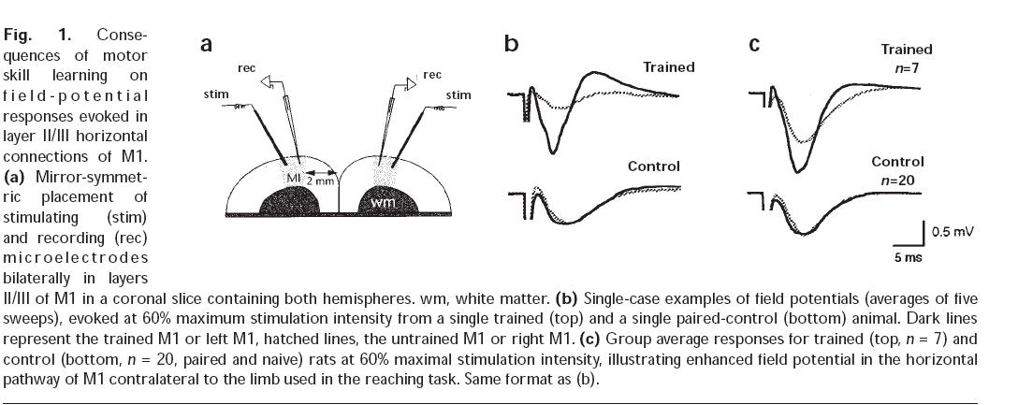
Detectability
Example from Rioult-Pedotti - 1998
The amplitude of field potentials in the forelimb region contralateral to the trained limb was significantly increased relative to the opposite ‘untrained’ hemisphere.

Slide 26
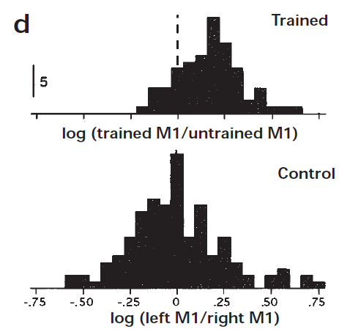
Detectability e.g. Reaching Task
Ratio of Amplitudes
Rioult-Pedotti, et al., 1998

Slide 27
Proof the SPM Hypothesis
Detectability: If an animal displays memory of some previous experience, a change in
synaptic efficacy should be detectable somewhere in its nervous system.
Mimicry: Conversely, if it were possible to induce the same spatial pattern of synaptic weight
changes artificially, the animal should display 'apparent' memory for some past experience
which did not in practice occur.
Anterograde Alteration: Interventions that prevent the induction of synaptic weight changes
during a learning experience should impair the animal's memory of that experience.
Retrograde Alteration: Interventions that alter the spatial distribution of synaptic weights
induced by a prior learning experience (see detectability) should alter the animal's memory
of that experience.
Martin et al., 2000; Martin and Morris, 2002

Slide 28
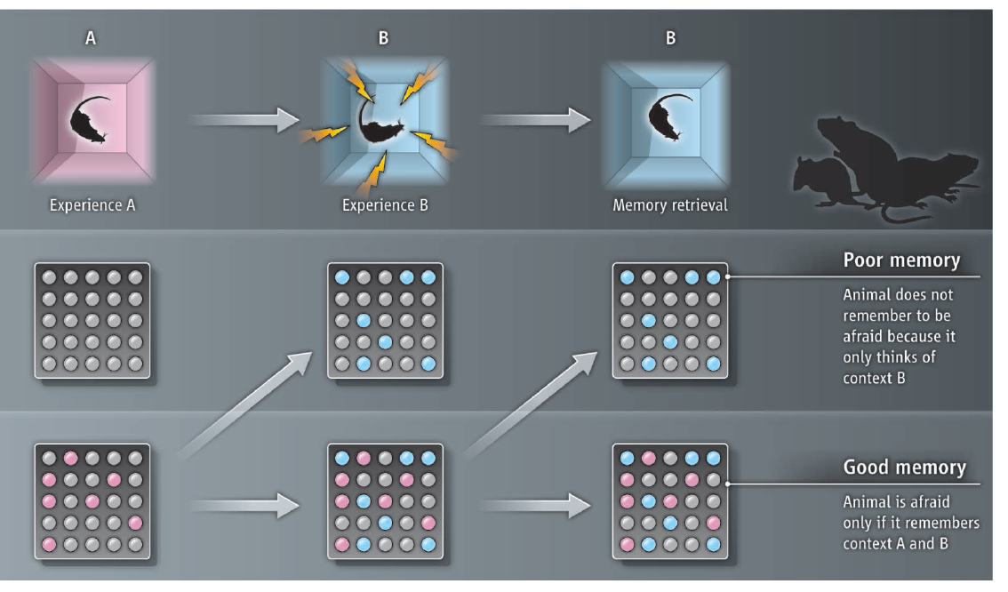
Mimicry of memory
Figure adapted from Morris and Takeuchi, 2012
Context
“B” pattern
“B” pattern only
Non-activated
case
“A” pattern
“A”+”B” pattern
“A”+”B” pattern
“A”-Activated
case
The memory of context “A” is first marked in a chemically genetic manner (pink neurons). This memory is then activated by using a drug (Garner et al., 2012) or by optogenetic stimulation (Liu et al., 2012) while the animal is in a different place - context “B” (blue neurons) - and subject to fear conditioning. Later memory retrieval is only successful if the animal remembers both contexts “A” + “B” (pink and blue neurons). If the drug or stimulation is not been present during retrieval, the pattern of neuronal firing is different and does not induce the related fear behavior.

Slide 29
Proof the SPM Hypothesis
Detectability: If an animal displays memory of some previous experience, a change in
synaptic efficacy should be detectable somewhere in its nervous system.
Mimicry: Conversely, if it were possible to induce the same spatial pattern of synaptic weight
changes artificially, the animal should display 'apparent' memory for some past experience
which did not in practice occur.
Anterograde Alteration: Interventions that prevent the induction of synaptic weight changes
during a learning experience should impair the animal's memory of that experience.
Retrograde Alteration: Interventions that alter the spatial distribution of synaptic weights
induced by a prior learning experience (see detectability) should alter the animal's memory
of that experience.
Martin et al., 2000; Martin and Morris, 2002

Slide 30
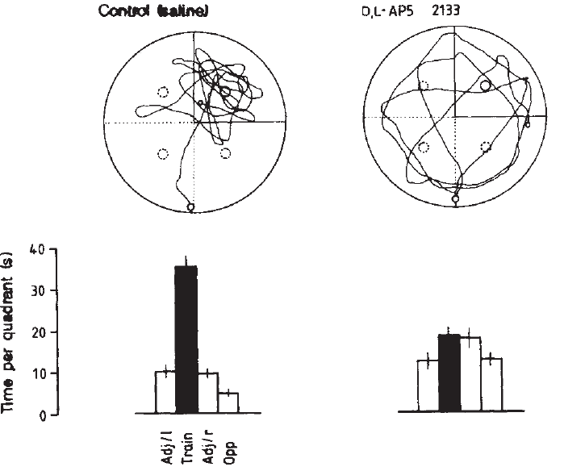
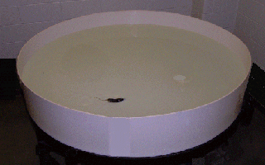
Anterograde Alteration e.g. Morris Water Maze
Learn the position of the platform
Control
Blocked LTP
2
1
platform
4
3
rat
Time per quadrant (sec)
1
2
3
4
1
2
3
4
Morris et al., 1986

Slide 31
Anterograde Alteration e.g. Morris Water Maze
Learn the position of the platform
Control
Blocked LTP
2
1
platform
4
3
rat
Time per quadrant (sec)
1
2
3
4
1
2
3
4
Morris et al., 1986

Slide 32
Proof the SPM Hypothesis
Detectability: If an animal displays memory of some previous experience, a change in
synaptic efficacy should be detectable somewhere in its nervous system.
Mimicry: Conversely, if it were possible to induce the same spatial pattern of synaptic weight
changes artificially, the animal should display 'apparent' memory for some past experience
which did not in practice occur.
Anterograde Alteration: Interventions that prevent the induction of synaptic weight changes
during a learning experience should impair the animal's memory of that experience.
Retrograde Alteration: Interventions that alter the spatial distribution of synaptic weights
induced by a prior learning experience (see detectability) should alter the animal's memory
of that experience.
Martin et al., 2000; Martin and Morris, 2002

Slide 33
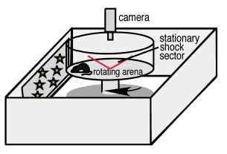
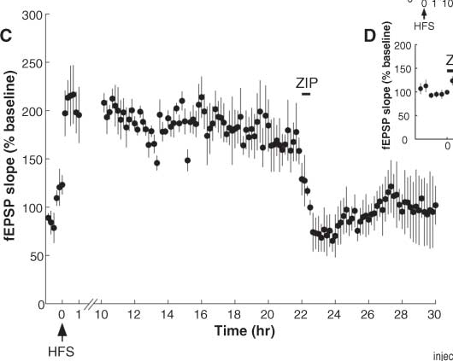
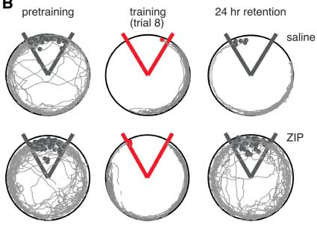
Retrograde Alteration e.g. Place Avoidance
drug
induction
drug
LTP
induction
Pastalkova et al., 2006

Slide 34
Proof the SPM Hypothesis
Detectability: If an animal displays memory of some previous experience, a change in
synaptic efficacy should be detectable somewhere in its nervous system.
Mimicry: Conversely, if it were possible to induce the same spatial pattern of synaptic weight
changes artificially, the animal should display 'apparent' memory for some past experience
which did not in practice occur.
Anterograde Alteration: Interventions that prevent the induction of synaptic weight changes
during a learning experience should impair the animal's memory of that experience.
Retrograde Alteration: Interventions that alter the spatial distribution of synaptic weights
induced by a prior learning experience (see detectability) should alter the animal's memory
of that experience.
only evidences!!!
Martin et al., 2000; Martin and Morris, 2002

Slide 35
Back to the Math. We had:
dω₁
Single Input
= μ v u₁ μ << 1
dt
dw
Many Inputs
= μ v u μ << 1
dt
As v is a single output, it is scalar.
Averaging Inputs
dw
= μ <v u> μ << 1
dt
We can just average over all input patterns and approximate the weight change by this. Remember, this assumes that weight changes are slow.
If we replace v with w . u we can write:
dw
= μ Q . w where Q = <uu> is
the input correlation
matrix
dt
Note: Hebb yields an instable (always growing) weight vector!

Slide 36
Covariance Rule(s)
Normally firing rates are only positive and plain Hebb would yield only LTP.
Hence we introduce a threshold to also get LTD
dw
= μ (v - Θ) u μ << 1
dt
Output threshold
dw
= μ v (u - Θ) μ << 1
Input vector threshold
dt
Many times one sets the threshold as the average activity of some
reference time period (training period)
Θ = <v> or Θ = <u> together with v = w . u we get:
dw
= μ C . w, where C is the covariance matrix of the input
dt
http://en.wikipedia.org/wiki/Covariance_matrix
C = <(u-<u>)(u-<u>)> = <uu> - <u²> = <(u-<u>)u>

Slide 37
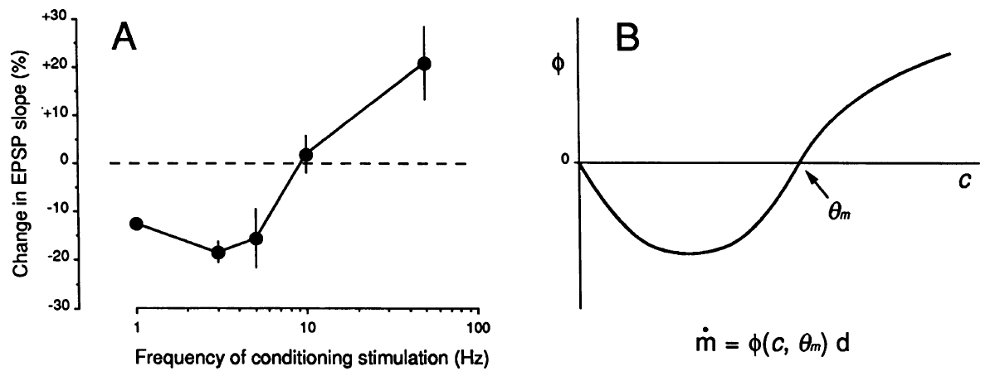
The covariance rule can produce LTD without (!) post-synaptic input.
This is biologically unrealistic and the BCM rule (Bienenstock, Cooper,
Munro) takes care of this.
BCM- Rule
dw
= μ vu (v - Θ) μ << 1
dt
Experiment
BCM-Rule
dw
v
post
≠
pre
u
Dudek and Bear, 1992
Notes:
37

Slide 38
The covariance rule can produce LTD without (!) post-synaptic input.
This is biologically unrealistic and the BCM rule (Bienenstock, Cooper,
Munro) takes care of this.
BCM- Rule
dw
= μ vu (v - Θ) μ << 1
dt
Experiment
BCM-Rule
dw
v
post
≠
pre
u
Dudek and Bear, 1992
Notes:
38

Slide 39
The covariance rule can produce LTD without (!) post-synaptic input.
This is biologically unrealistic and the BCM rule (Bienenstock, Cooper,
Munro) takes care of this.
BCM- Rule
dw
= μ vu (v - Θ) μ << 1
dt
As such this rule is again unstable, but BCM introduces a sliding threshold
dΘ
= ν (v² - Θ) ν < 1
dt
Note the rate of threshold change ν should be faster than then weight
changes (μ), but slower than the presentation of the individual input
patterns. This way the weight growth will be over-dampened relative to the
(weight – induced) activity increase.
Notes:
39

Slide 40
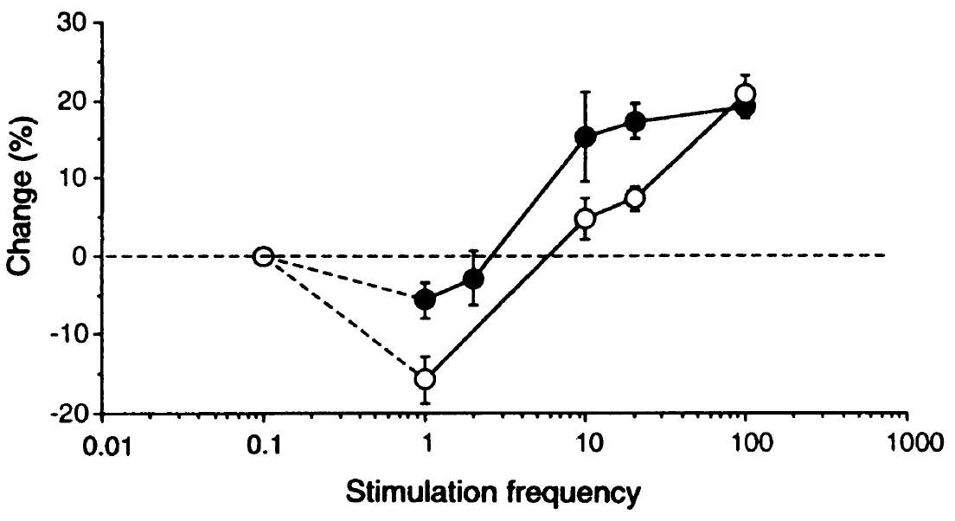
less input leads to shift of threshold to enable more LTP
Kirkwood et al., 1996
open: control condition
filled: light-deprived
BCM is just one type of (implicit) weight normalization.

Slide 41
Evidence for weight normalization:
Reduced weight increase as soon as weights are already big
(Bi and Poo, 1998, J. Neurosci.)
BCM is just one type of (implicit) weight normalization.

Slide 42
Other Weight normalization mechanisms
Bad News: There are MANY ways to do this and results of learning may vastly differ with the used normalization method. This is one down-side of Hebbian learning.
In general one finds two often applied schemes:
Subtractive and multiplicative weight normalization.
Example (subtractive):
With N, number of inputs and n a unit vector (all “1”). This yields that
n.u is just the sum over all inputs.
Note: This normalization is rigidly applied at each learning step. It requires global information (info about ALL weights), which is biologically unrealistic.
One needs to make sure that weight do not fall below zero (lower bound).
Also: Without upper bound you will often get all weight = 0 except one.
Subtractive normalization is highly competitive as the subtracted values are always the same for all weight and, hence, will affect small weight relatively more.

Slide 43
Weight normalization:
Example (multiplicative):
dw
= μ (vu – α v²w), α>0
dt
(Oja’s rule, 1982)
Note: This normalization leads to an asymptotic convergence of |w|² to 1/α.
It requires only local information (pre-, post-syn. activity and the local synaptic weight).
It also introduces competition between the weights as growth of one weight will force the other into relative re-normalization (as the length of the weight vector |w|² remains always limited.

Slide 44
Eigen Vector Decomposition - PCA
We had:
Averaging Inputs
dw
= μ <v u> μ << 1
dt
We can just average over all input patterns and approximate the weight change by this. Remember, this assumes that weight changes are slow.
If we replace v with w . u we can write:
dw
= μ Q . w where Q = <uu> is
the input correlation
matrix
dt
And write: Q.e_{ν} = λ_{ν}e_{ν},
where e_{ν} is an eigenvector of Q and λ_{ν} is an eigenvalue, with
= 1,….,N. Note for correlation matrices all eigenvalues are real
and non-negative.
As usual, we rank-order the eigenvalues: λ₁≥λ₂≥…≥λ_{N}

Slide 45
Eigen Vector Decomposition - PCA
Every vector can be expressed as a linear combination of its eigenvectors:
**
Where the coefficients are given by:
*
dw
Entering in
= μ Q . w
And solving for c_{ν} yields:
dt
Using * with t=0 we can rewrite ** to:
Non-trivial step, see
Chapters 8 and then 7
In Dayan and Abbott

Slide 46
Eigen Vector Decomposition - PCA
As the λ’s are rank-ordered and non-negative we find that for long t only the
first term will dominate this sum. Hence:
and, thus,:
As the dot product corresponds to a projection of one vector onto another,
we find that hebbian plasticity produces an output v proportional to the pro-
jection of the input vector u onto the principal (first) eigenvector e₁ of the
correlation matrix of the inputs used during training.
Note
will get quite big over time and, hence, we need normalization!
A good way to do this is to use Oja’s rule which yields:

Slide 47
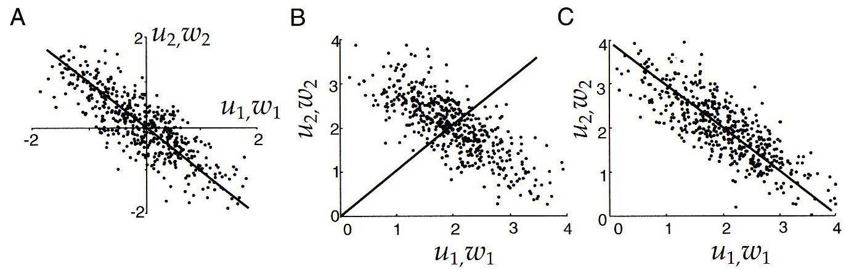
Eigen Vector Decomposition - PCA
Panel A shows the input distribution (dots) for two inputs u, which is Gaussian with mean zero and the alignment of the weight vector w using the basic Hebb rule. The vector aligns with the main axis of the distribution. Hence, here we have something like PCA.
Panel B shows the same when the mean is non zero. No alignment occurs.
Panel C shows the same when applying the covariance Hebb rule. Here we have the same as in A.(One has subtracted the average!)

Slide 48
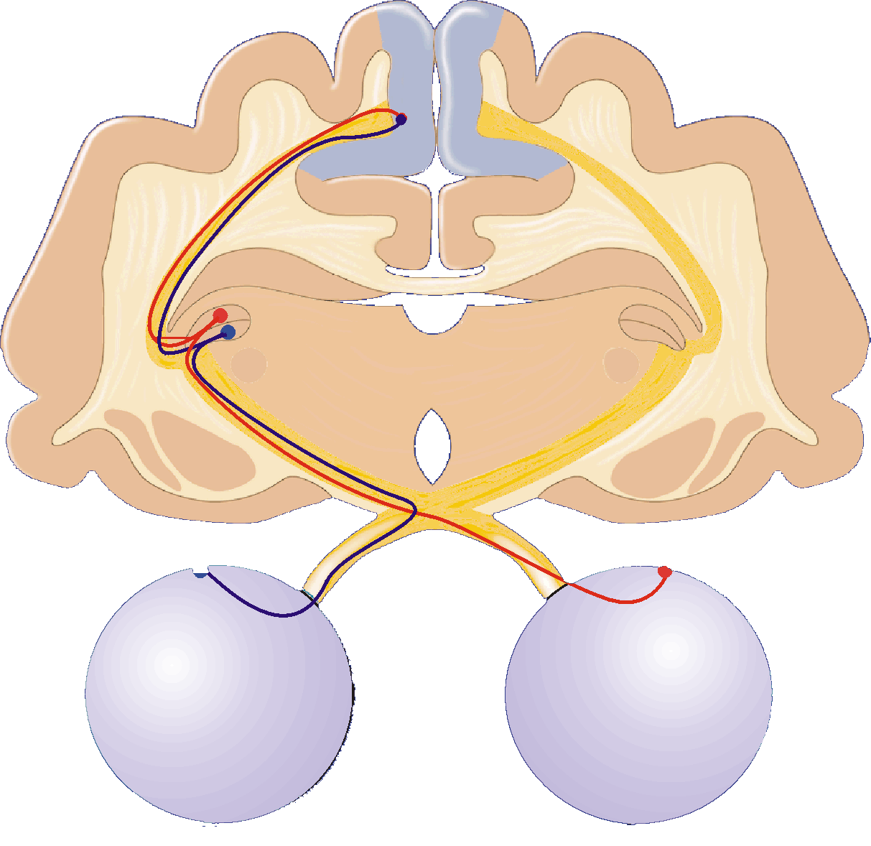
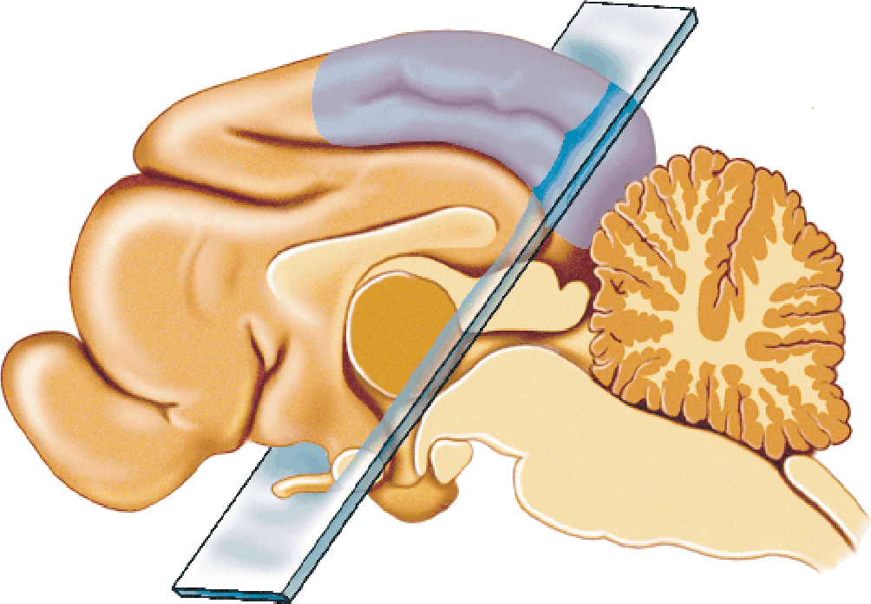
Visual Pathway – Towards Cortical Selectivities
Visual Cortex
Receptive fields are:
Binocular
Orientation Selective
Area
17
LGN
Receptive fields are:
Monocular
Radially Symmetric
Retina
light electrical signals
Notes:
I have chosen to use the visual cortex as a model system. It is a good system since there is a lot of experimental data about the VC plasticity and because it is easy to directly control the inputs to the visual cortex.
Now Describe visual pathway
Stress monocular LGN with no orientation selectivity + radially symmetric.

Slide 49
Normal
Monocular Deprivation
Left
Right
Right
Response (spikes/sec)
Left
angle
angle
20
30
% of cells
15
Ocular dom, group
10
Left dom
1 2 3 4 5 6 7
1 2 3 4 5 6 7
group
Right dom
group
Notes:
Cells in visual cortex show varying degrees of ocular dominance. Cells can be classified by their degree of ocular dominance.
Point to OD and explain. If an animal is monocularly deprived by lid suture it alters the OD histogram – as seen in first slide etc.
Show OD histogram.

Slide 50
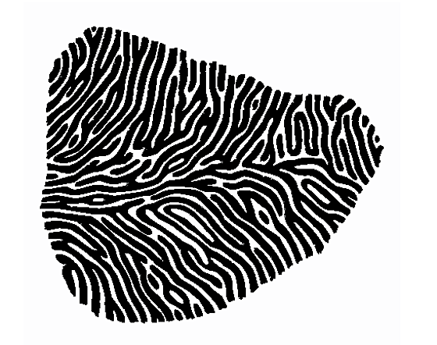
Modelling Ocular Dominance – Networks
The ocular dominance map:
Left
Right
With gradual transitions
Magnification (monkey)
Larger Map after thresholding
(Monkey)

Slide 51
Modelling Ocular Dominance – Single Cell
Left
u_{l}
w_{l}
v
Eye input
w_{r}
l
Right
u_{r}
We need to generate a situation where through Hebbian learning one
synapse will grow while the other should drop to zero.
Called: Synaptic competition (Remember “weight normalization”!)
We assume that right and left eye are statistically the same and, thus,
get as correlation matrix Q:
<u_{r}u_{r}>
<u_{r}u_{l}>
q_{S}
q_{D}
Q = <uu> =
=
<u_{l}u_{r}>
<u_{l}u_{l}>
q_{D}
q_{S}

Slide 52
Modelling Ocular Dominance – Single Cell
Eigenvectors are:
and
with eigenvalues
and
dw
Using the correlation based Hebb rule:
= μ Q . w
dt
And defining:
and
We get:
and
We can assume that after eye-opening positive activity correlations between
the eyes exist. Hence:
And it follows that e₁ is the principal eigenvector leading to equal weight
growth for both eyes, which is not the case in biology!

Slide 53
Modelling Ocular Dominance – Single Cell
Weight normalization will help, (but only subtractive normalization works
as multiplicative normalization will not change the relative growth of w+ as
compared to w-):
As:
we have e₁ ~ n which eliminates weight growth of w₊
(because entering e₁ into the above yields: )
While, on the other hand: e₂ . n = 0, (vectors are orthogonal).
Hence the weight vector will grow parallel to e₂, which requires the one to grow and the other to shrink.
What really happens is given by the initial conditions of w(0).
If:
w_{r} will increase, otherwise w_{l} will grow.

Slide 54
Modelling Ocular Dominance – Networks
The ocular dominance map:
Left
Right
With gradual transitions
Magnification (monkey)
Larger Map after thresholding
(Monkey)

Slide 55
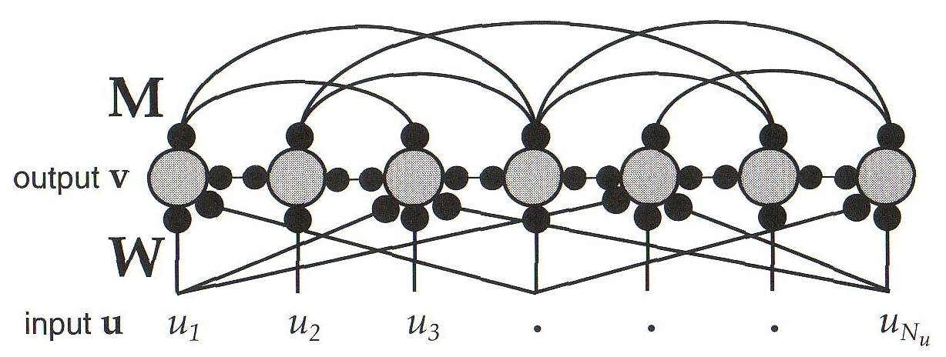
Modelling Ocular Dominance – Networks
To receive an ocular dominance map we need a small network:
Here the activity components v_{i} of each neuron collected into
vector v are recursively defined by:
Where M is the recurrent weight matrix and W the feed-forward weight matrix.
If the eigenvalues of M are smaller than 1 than this is stable and we get as
the steady state output:

Slide 56
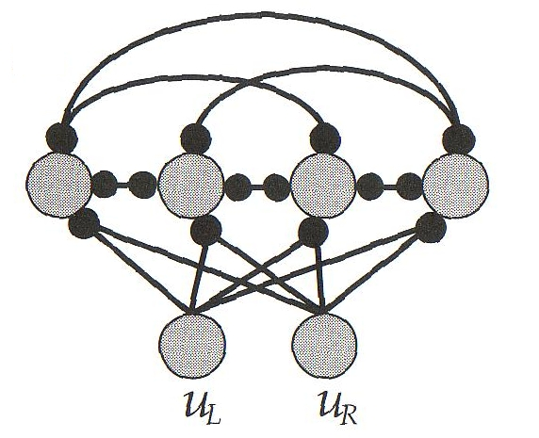
Modelling Ocular Dominance – Networks
Defining the inverse:
Where I is the identity matrix. This way we can rewrite:
An ocular dominance map can be achieved similar to the single cell model
but by assuming constant intracortical connectivity M.
We use this network:

Slide 57
Modelling Ocular Dominance – Networks
We get for the weights:
Similar to the correlation based rule!
where Q=<uu> is the autocorrelation matrix.
For the simple network (last slide) we can write:
afferent
intra-cortical
Again we define w₊ and w₋ (this time as vectors!) and get:
and
With subtractive normalization we can again neglect w₊
Hence the growth of w- is dominated by the principal eigenvector of K

Slide 58
Modelling Ocular Dominance – Networks
We assume that the intra-cortical connection structure is similar everywhere and, thus, given by K(|x-x’|). Note: K is NOT the connectivity matrix. Let us assume that K takes the shape of a difference of Gaussians.
K
Note: In some way this is a „trick“: we assume that K takes this shape in oder to get the right result in the end….
K can be thought of as factor that spatially modulates the input correlations given by q_{s} and q_{d}.
0
Intra-cortical Distance
If we assume periodic boundary conditions in our network we can calculate the eigenvectors e^{ν} as:
*

Slide 59
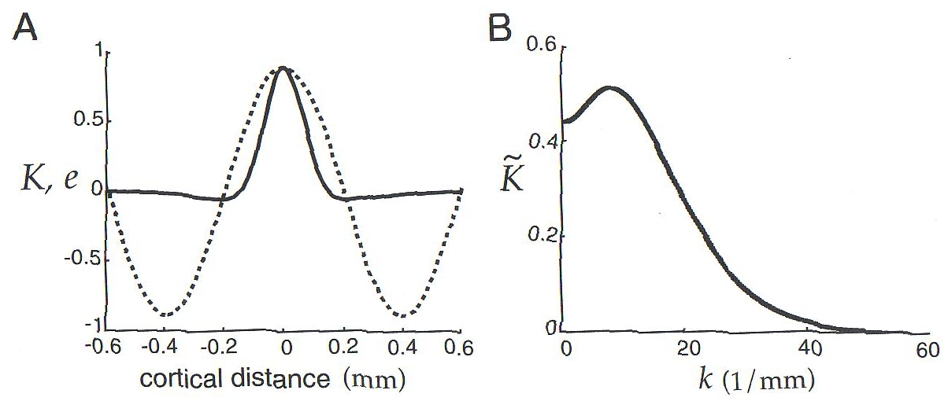
Modelling Ocular Dominance – Networks
~
argmax K
~
The eigenvalues are given by the Fourier Transform K of K
The principal eigenvector is given by * (last slide) with:
The diagram above plots another difference of Gaussian K function (A, solid), its Fourier transform K (B), and the principal eigenvector (A, dotted). The fact that the eigenvector’s sign alternates leads to alternating left/right eye dominance just like for the single cell example discussed earlier.
~

